Slide 1
Using Gitlab
Nextech Solutions
Sign on to Gitlab

Slide 2

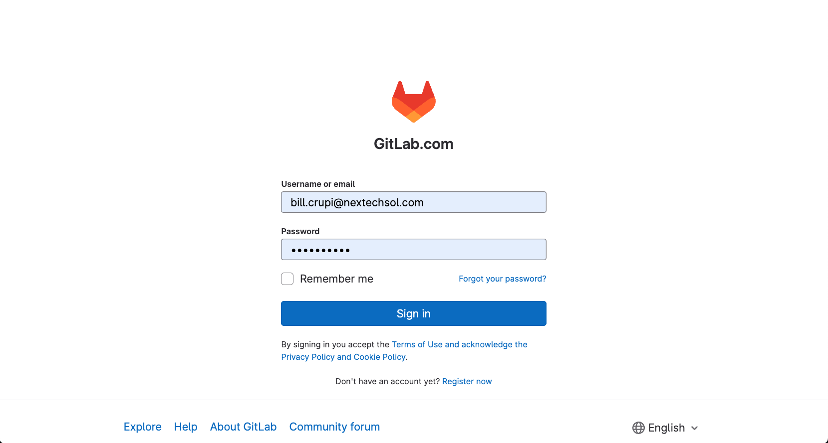
Step 1 – Sign on to Gitlab
Enter
Username
Password

Slide 3
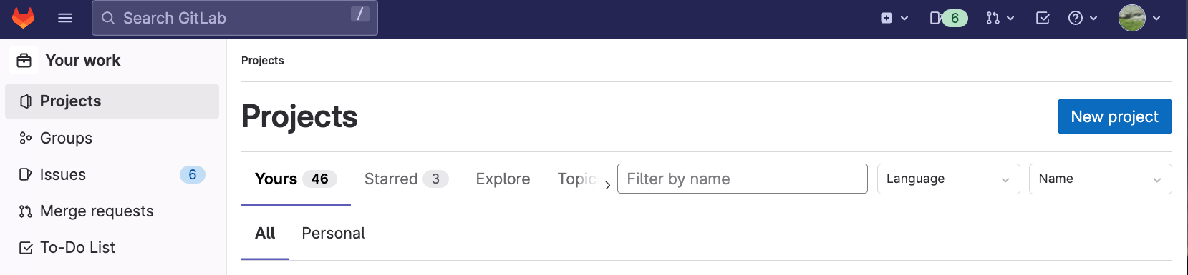
Step 2 – Create a Project in Gitlab
Click New project

Slide 4
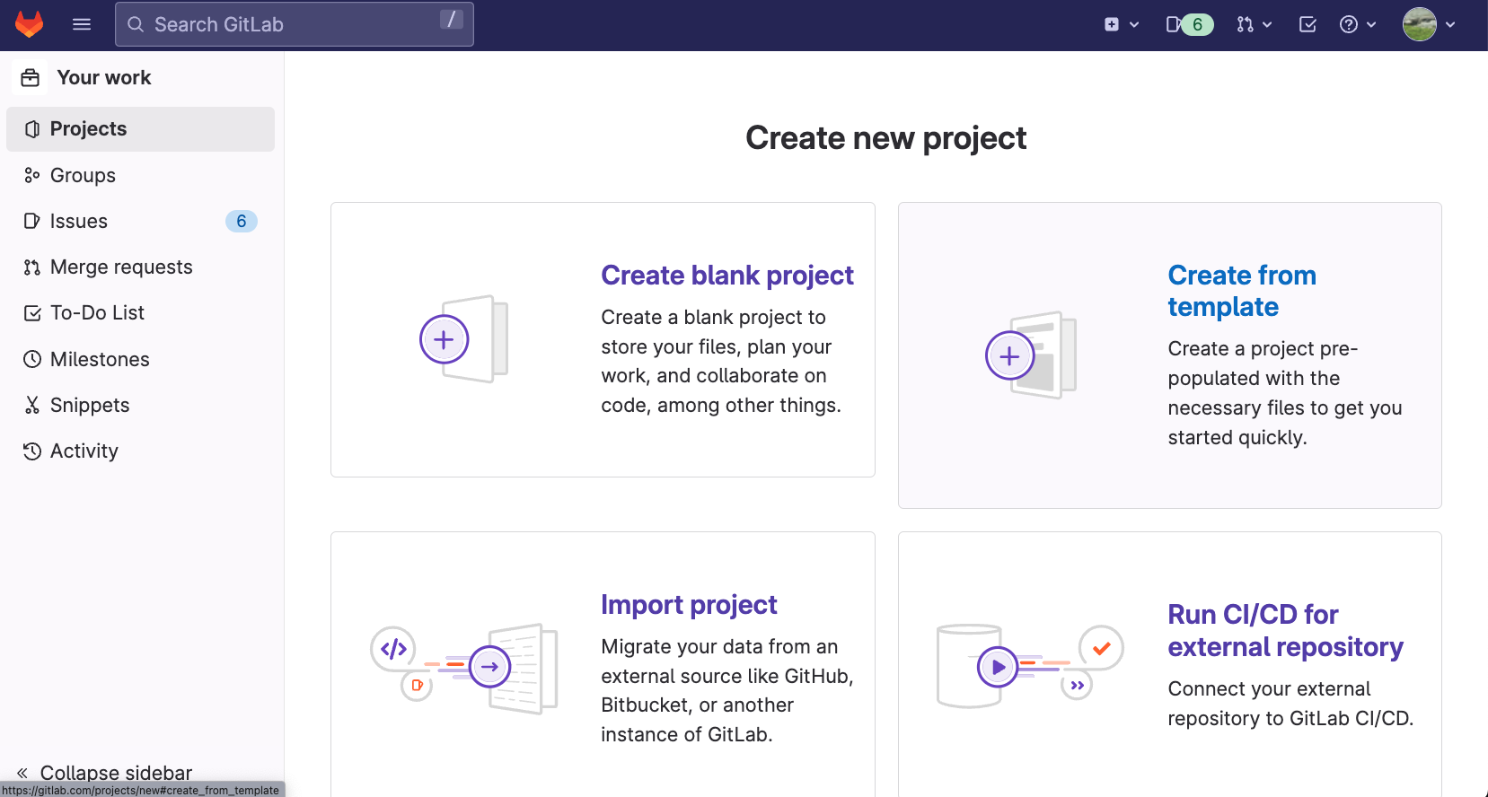
Step 2 – Create new project
Nextech Solutions

Slide 5
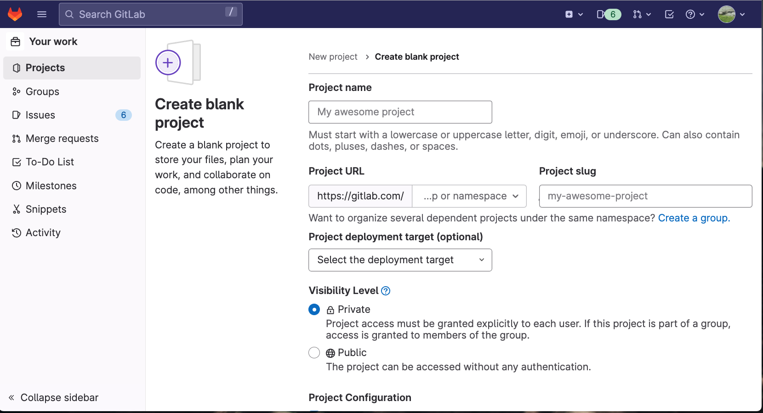
Step 3 – Fill out information
Nextech Solutions

Slide 6
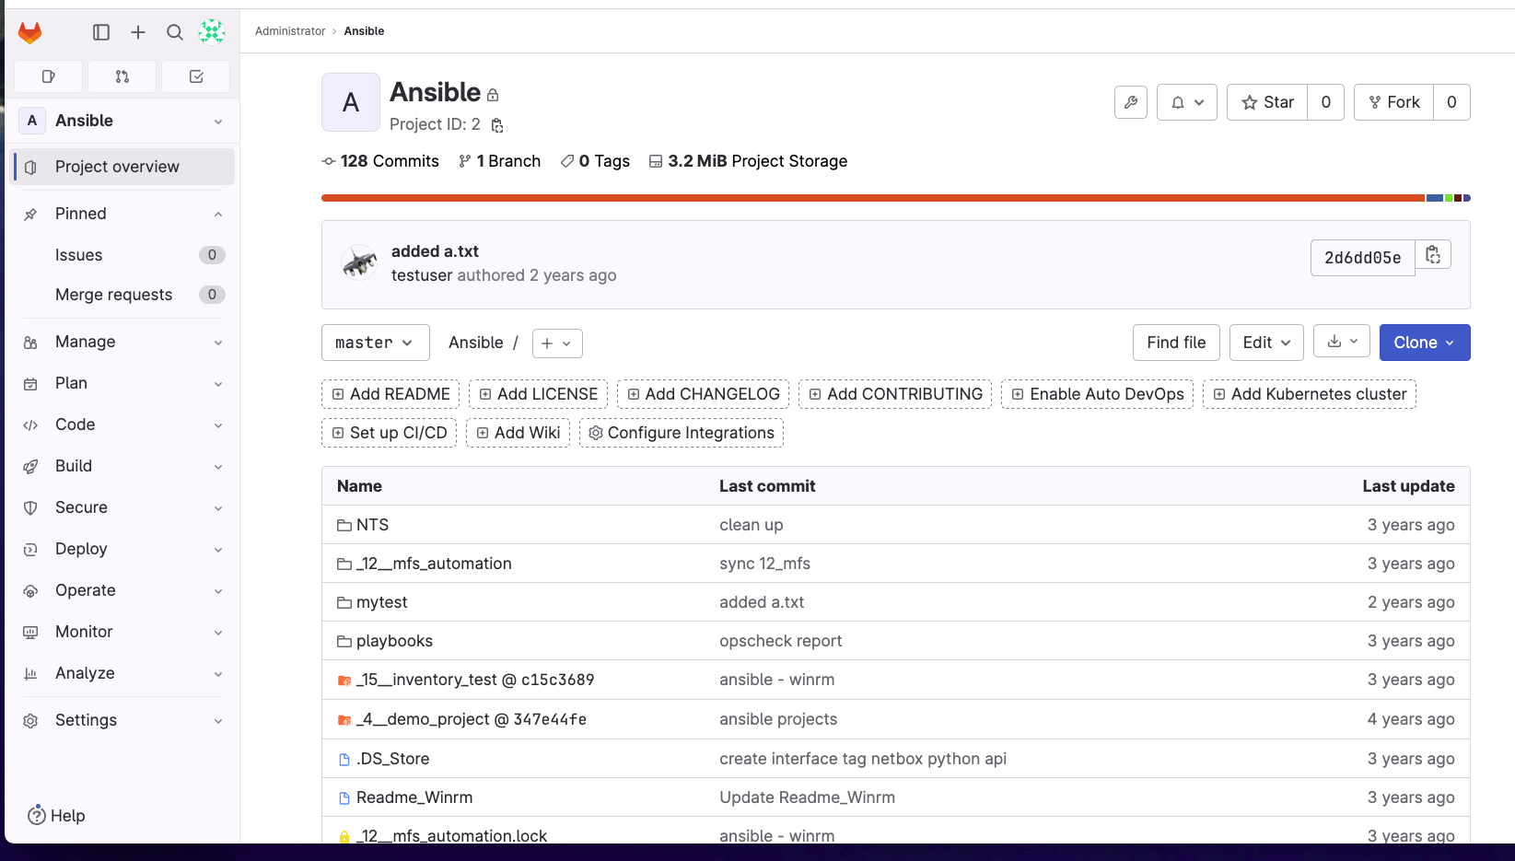
Using Gitlab
Nextech Solutions
Using Gitlab

Slide 7
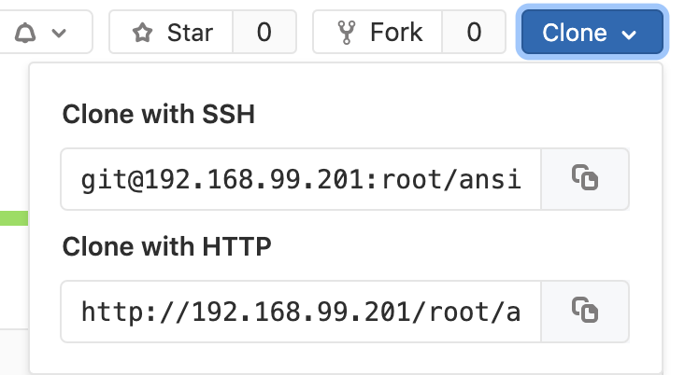
Step 3 – Click the Clone button
Nextech Solutions
Clone with HTTP (hit copy button next to url.
On a client with Git installed run the following commands.
$ git clone http://192.168.99.201/root/ansible.git
Cloning into 'ansible'...
remote: Enumerating objects: 85, done.
remote: Counting objects: 100% (85/85), done.
remote: Compressing objects: 100% (78/78), done.
remote: Total 85 (delta 30), reused 0 (delta 0)
Unpacking objects: 100% (85/85), done.
Williams-MacBook-Pro:nts_github williamcrupi$

Slide 8
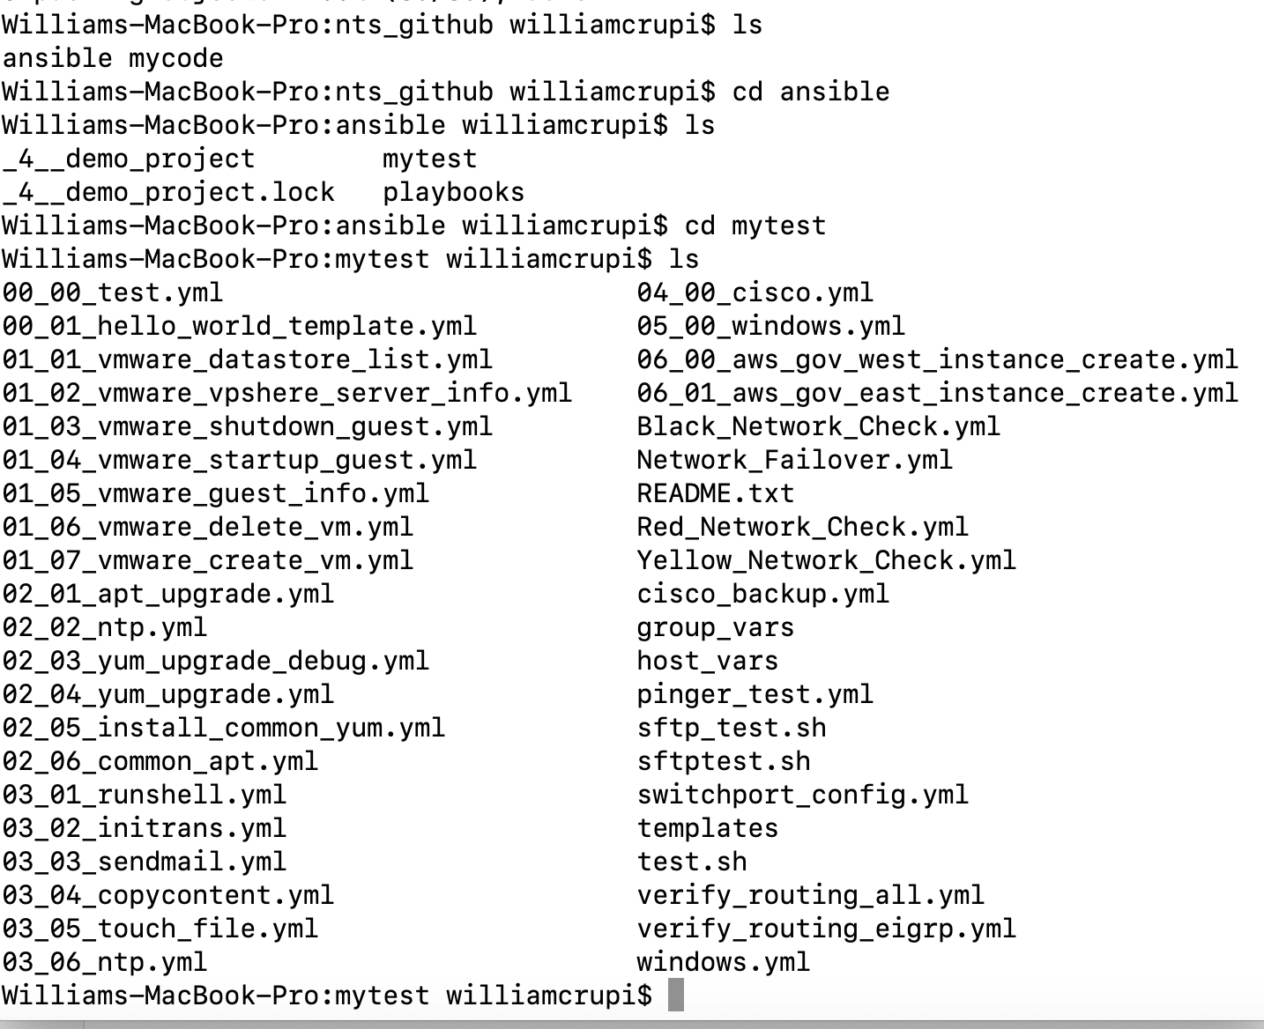
View directory structure after clone
Once the files are cloned you can start updating files, adding new ones, and deleting others.
Edit file (mac: vi 02_02_.ntp.yml
Run: git status
Run: git add .
Run: git commit –a –m “update ntp”
Run: git push origin master
Run: it may ask for username and password

Slide 9
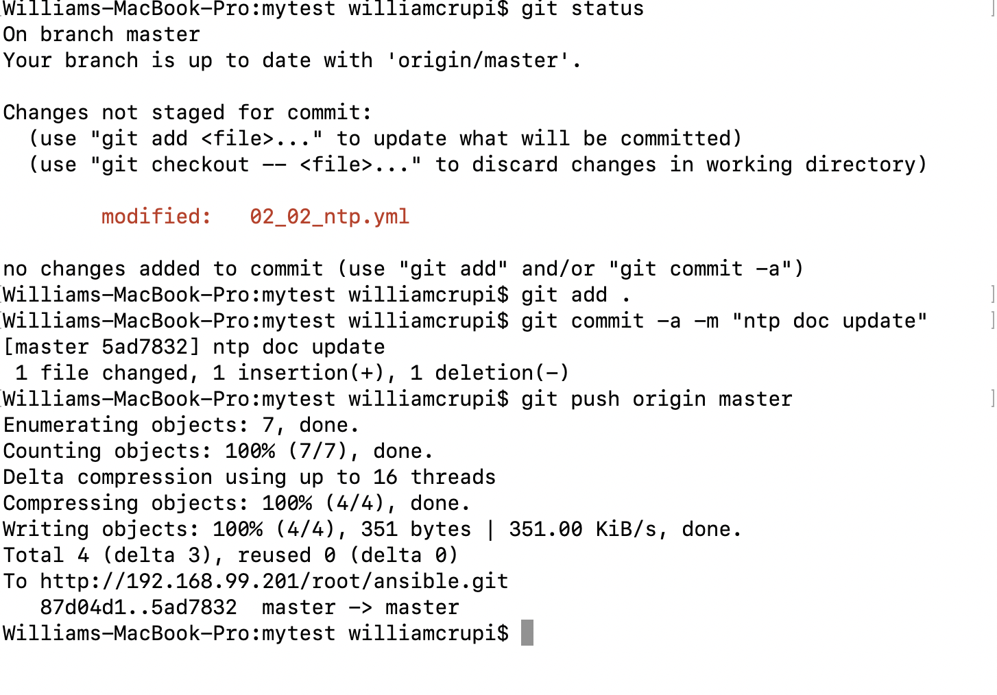
Using GitLab
Run of commands on previous slide.
Once you clone a repository always run: git pull
before you do any work if it was
already cloned.

Slide 10
Using GitLab
For a deeper dive see the following link:
Learning GitLab

Slide 11
Github Flow
Nextech Solutions
Working Directory
Git Add
Staging
Git commit
Git Push
Remote Repository
Local Repository
Git pull

Slide 12
Gitlab and Github – Sharing commits with coworkers via the golden repo
Nextech Solutions
Step 2: Alice pushes the
Branche to the golden repo
Golden repo
(on Gitlab)
Step 3: Brian pulls the branch
From the golden repo
Alice’s repo
(on her computer)
Brian’s repo
(on his computer)
Step 1: Alice commits to a branch in her
local repo
Step 4: Brian has the branch with
Alice’s commits in his local repo

Slide 13
Branching
Nextech Solutions
Master
Existing branch
git checkout branch-name
Creating a new branch
git checkout –b branch-name
0
1
54-bugfix

Slide 14
Git commands
Nextech Solutions
If you run git checkout - <file-name>
# This will revert file back to the status at the last point. This only works on files that have already been saved and committed to Git.
Git merge branch-name-to-merge
git checkout main
git merge hotfix
GitLab
1. Create branch in gitlab
2. git fetch
3. Git checkout issue-1
4. Git merge main issue-1
5. Git push

Slide 15
Git Commands – Setting up git Repo
Nextech Solutions
$ git –-version
$ git config –-list
$ git config –-global user.email “bill.crupi@nextechsol.com”
$ git config -–global user.name “Bill Crupi”
$ git config -–global init.defaultBranch main
$ git branch # lists all available branches
$ git branch –-list # same as git branch (not usually used)
$ git branch foo # makes a new branch called foo
$ git branch –-delete foo # deletes a branch called foo

Slide 16
Git Commands – Setting up git Repo
Nextech Solutions
$ git branch -–create foo
$ git branch –-delete foo
$ mkdir newdirectory
$ cd newdirectory
$ git status
fatal: not a git repository (or any of the parent directories): .git
$ git init
$ git status
On branch main
Your branch is up to date with 'origin/main'.
nothing to commit, working tree clean

Slide 17
Git Commands – Setting up git Repo
Nextech Solutions
$ touch todo.txt
$ git add todo.txt
$ git commit -–message “add list of tasks to do”
$ git log
$ git add .gitignore
Example
# ignore ALL .log files
*.log
#ignore All files in Any directory named temp
temp/
$ git commit –-message “exclude notes file and blah”
$ git tag version-1-0-beta

Slide 18
Git Commands
Nextech Solutions
$ git tag –-list
$ git tag –-delete version-1-0-beta

Slide 19

Git Branching
Nextech Solutions
Commit E on Branch-a
Commit C on main
Most Recent
commits
Commit D on Branch-a
Commit B on Main
TIME
Oldest
commits
Commit A on Main

Slide 20
Useful git commands
Nextech Solutions
git status (current status)
git diff (what changed since last update)

Slide 21
Git merge example
Nextech Solutions
Main (formally Master)
git merge 54-bugfix
0
1
3
4
2
5
6
When you're on the master branch and run git merge 54-bugfix, behind the scenes, Git grabs those two commits and then finds their closest common ancestor:
54-bugfix

Slide 22
Git merge example
Nextech Solutions
Main (formally Master)
0
1
3
4
2
5
6
54-bugfix

Slide 23
Three-way merge
Nextech Solutions
Main (formally Master)
0
1
3
4
7
Git then attempts a three-way merge using the ancestor, the commit to be merged into, and the commit to merge in. This creates a new commit from all three, which your master branch is now pointing at:
2
5
6
54-bugfix

Slide 24
Git Branching – Basic Branching and Merging
Nextech Solutions
Basic Branching and Merging
Let’s go through a simple example of branching and merging with a workflow that you might use in the real world. You’ll follow these steps:
Do some work on a website.
Create a branch for a new user story you’re working on.
Do some work in that branch.

Slide 25
Git Branching – Basic Branching and Merging
Nextech Solutions
At this stage, you’ll receive a call that another issue is critical and you need a hotfix. You’ll do the following:
Switch to your production branch.
Create a branch to add the hotfix.
After it’s tested, merge the hotfix branch, and push to production.
Switch back to your original user story and continue working.

Slide 26
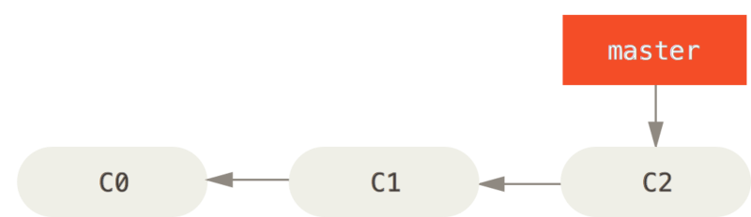
Git Branching – Basic Branching and Merging
Nextech Solutions
Basic Branching
First, let’s say you’re working on your project and have a couple of commits already on the master branch.
A simple commit history

Slide 27
Git Branching – Basic Branching and Merging
Nextech Solutions
You’ve decided that you’re going to work on issue #53 in whatever issue-tracking system your company uses. To create a new branch and switch to it at the same time, you can run the
git checkout command with the -b switch:
$ git checkout -b iss53 Switched to a new branch "iss53”
$ git branch iss53
$ git checkout iss53

Slide 28
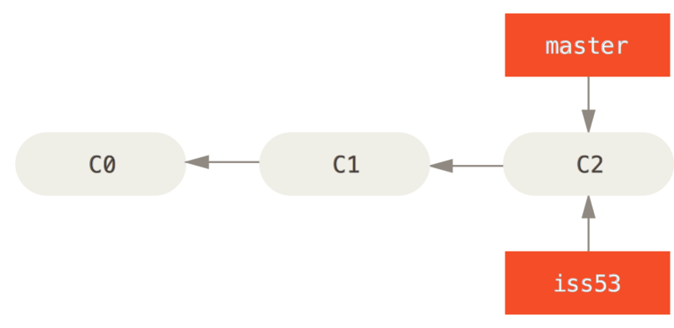
Git Branching – Basic Branching and Merging
Nextech Solutions
Creating a new branch pointer

Slide 29
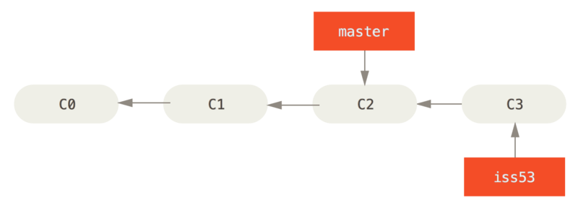
Git Branching – Basic Branching and Merging
Nextech Solutions
You work on your website and do some commits. Doing so moves the iss53 branch forward, because you have it checked out (that is, your HEAD is pointing to it):
The iss53 branch has moved forward with your work

Slide 30
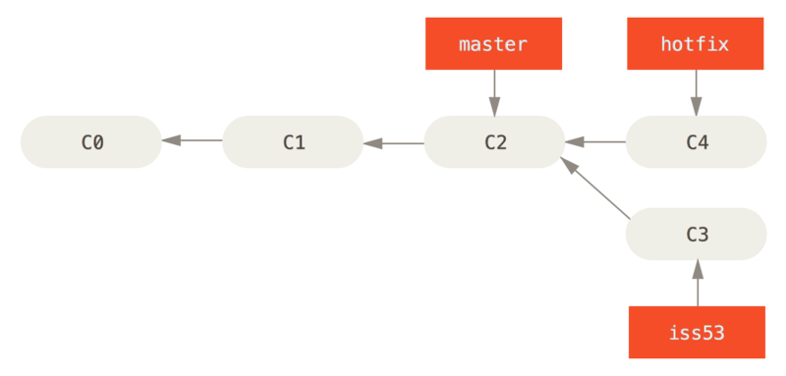
Git Branching – Basic Branching and Merging
Nextech Solutions
$ git checkout master ------Switched to branch 'master’
$ git checkout -b hotfix -------Switched to a new branch 'hotfix’
$ vim index.html
$ git commit -a -m 'Fix broken email address [hotfix 1fb7853] Fix broken email address’ $ git checkout -b hotfix ---- Switched to a new branch 'hotfix’
$ vim index.html
$ git commit -a -m 'Fix broken email address [hotfix 1fb7853] Fix broken email address’

Slide 31
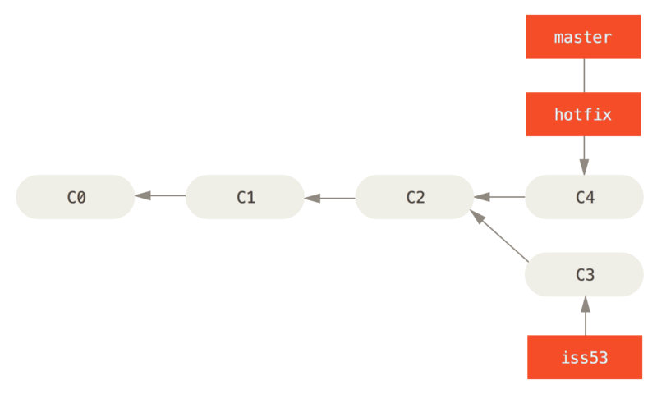
Git Branching – Basic Branching and Merging
Nextech Solutions
$ git checkout master
$ git merge hotfix Updating f42c576..3a0874c Fast-forward index.html | 2 ++ 1 file changed, 2 insertions(+)

Slide 32
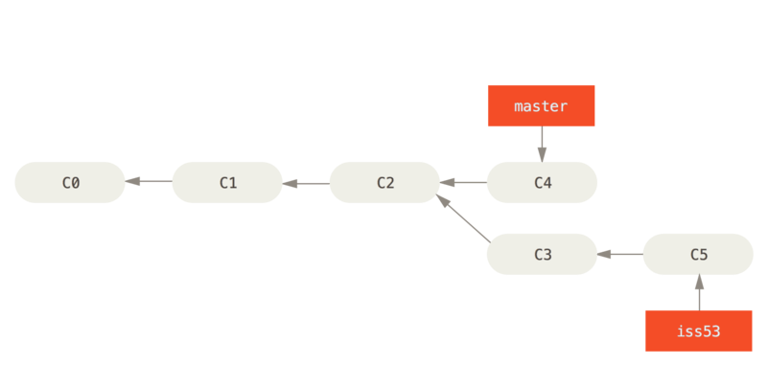
Git Branching – Basic Branching and Merging
Nextech Solutions
$ git branch -d hotfix ---- Deleted branch hotfix (3a0874c).
$ git checkout iss53 ----Switched to branch "iss53"
$ vim index.html
$ git commit -a -m 'Finish the new footer [issue 53]’
[iss53 ad82d7a] Finish the new footer [issue 53] 1 file changed, 1 insertion(+)

Slide 33
Git flow
Nextech Solutions
Develop
Releases
Hotfixes
Master
Feature Branches
0
1
3
2
4
Time
As you can see, there are a number of different streams. You have the master branch, hotfix branches for fixing emergency bugs, releases, the develop branch, and feature branches. These all have very particular uses, which we'll go into now.
5
6
7
8
9
10
12
11

Slide 34
Master/Main Branch
Nextech Solutions
The master (Main) branch is the original branch where all code is branched from. However, it is never committed to directly; it is only ever merged into. This branch is then used as the deployed branch or released branch. You should tag each merge with a version number to help identify these releases or deployed versions.

Slide 35
Development Branch
Nextech Solutions
The development branch is the other continuously existing branch as part of the git flow model.
All other branches are temporary and should be deleted after the work is finished.
This branch can often be the branch of the latest builds.
Development branch should not be merged into directly as well.
Feature builds should be merged into the Development.

Slide 36
Feature Branches
Nextech Solutions
Feature branches should be created from the development stream.
Work is committed to this branch directly.
Tag these branches with issue numbers is best practice.
When feature is completed and merged, common practice is to delete the branch.

Slide 37
Example Branches
Nextech Solutions
Feature Branches Develop
4
5
6
7
8

Slide 38
Release Branches
Nextech Solutions
Should be prefixed with release-
Branch should be created from development
No new features should be added, but bug fixes can be added.
Bugs should be merged back into the development branch.
When ready the release branch should be merged back into the master branch. (use major/minor number tag)
After merge into master then remerge back into the development branch.
After this is done delete the branch.

Slide 39
Example
Nextech Solutions
Develop Releases Master
7
8
9
11
10

Slide 40
Hotfixes
Nextech Solutions
Hotfixes are patches that are applied to critical bugs.
These are showstopping issues found in the main (master) branch.
Create a branch from master and name it hotfix-
Fix on a new commit then merge it back into master.
Tag master with new version minor or patch.
Merge into development.
Delete branch.

Slide 41
Hotfix example
Nextech Solutions
Develop Hotfixes Master
A
A
A
A

Slide 42
Gitlab Flow
Nextech Solutions
The Master (Main) branch is the default branch to merge work into.

Slide 43
Production Branch
Nextech Solutions
Feature branches
Master
Production
2
3
4
5
6
7

Slide 44
Gitlab flow
Nextech Solutions
Feature branches are branched directly from the master branch.
They are then merged back into the master branch.
Each feature branch can then be closed.
When you are ready merge master into your production branch.
At this point you can have a ci/cd to run against the production branch when it has been merged to.

Slide 45
Staging branch
Nextech Solutions
Staging branch is used if you need further testing by your QA team.
Pull code from master for feature branches
Merge feature branches into staging branches
After testing merge back into master and production.

Slide 46
Staging Branch
Nextech Solutions
Master
Staging
Production
2
3
5
4
6
7
8

Slide 47
Release Branch
Nextech Solutions
Release branches are pulled from the master.
Release branches are kept as reference.
They are merged back into the master.
Tag them with release numbers.
They can be used for testing with systems that are compatible with older systems.

Slide 48
Release Branches
Nextech Solutions
Master
2
Release 2.3
3
5
4
Release 2.4
6
7

Slide 49
Github flow
Nextech Solutions
Master
33-new-colors
0
34-introduce-workers
The main difference between the GitHub and GitLab flows is the flexibility of the latter. It provides blueprints for a number of different scenarios, each with slight differences in environment setup to cater to your project's needs. GitLab also avoids recommending the master for use in deployments, which can reduce the risk of bugs and ill effects being deployed.
1
2
3
4
5

Slide 50
Github flow
Nextech Solutions
Gitlab is more flexible that github.
Gitlab recommends not using master for deployments which reduce the risk of bugs.

Slide 51
Gitlab features
Nextech Solutions
How to create a project in GitLab
How to handle issues in Gitlab
How to handle merge requests in Gitlab

Slide 52
Creating Projects
Nextech Solutions
Go to the Gitlab URL.
Click the plus symbol (+) menu at the top right.
Select New Project.
On the Screen fill out the details of your new project.
Click Create Project

Slide 53
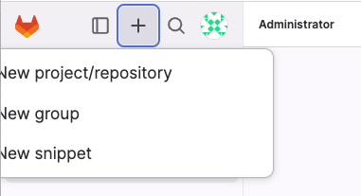
Create Projects Click the plus symbol (+) menu at the top Left.
Nextech Solutions

Slide 54
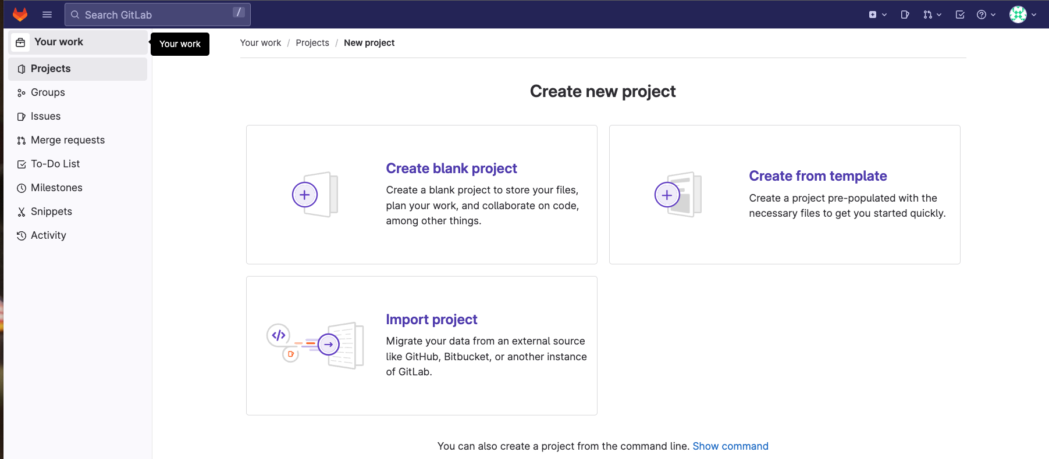
Select New Project.
Nextech Solutions

Slide 55
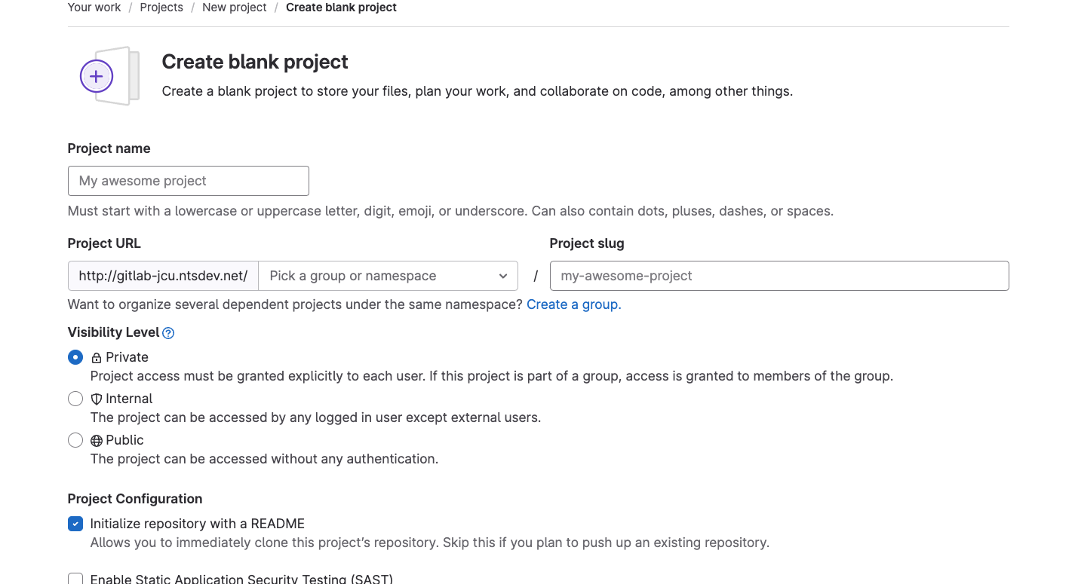
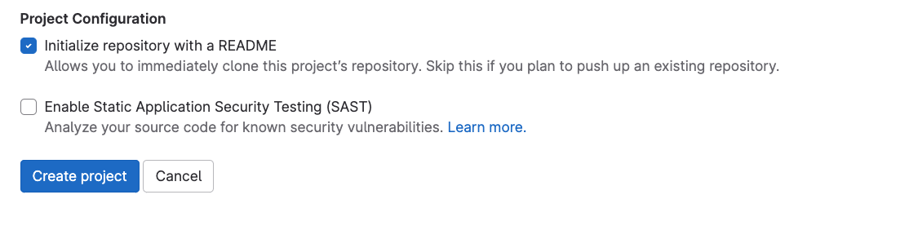
Fill out details and Click create project
Nextech Solutions

Slide 56
Project details that are important
Nextech Solutions
Project name should be descriptive and memorable
Description should explain what the project does.
Visibility Level should be limited to who should be able to see it and update it, … etc.

Slide 57
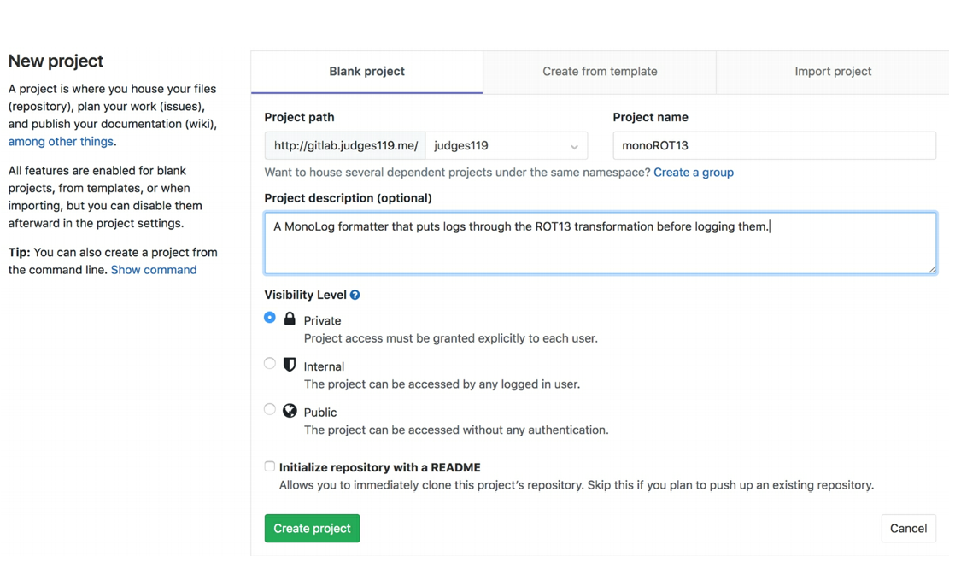
Project Visibility
Nextech Solutions

Slide 58
Creating an SSH Key
Nextech Solutions
Click the profile icon in the top-right corner
Click the settings link
Select SSH keys from the left-hand side of the menu
Paste your SSH key into the key section
Give you SSH key an informative and recognizable name
Click Add Key

Slide 59
Committing to a project
Nextech Solutions
git config –-global user.name “Biff Johnson”
git config –global user.email “Biff.johnson@world.com”

Slide 60
Blank slate
Nextech Solutions
git clone http://192.168.210.82/root/run_ansible_ci.git
Or
git@192.168.210.82:root/run_ansible_ci.git

Slide 61
Existing folder
Nextech Solutions
cd existing folder
git init
git remote add origin http://192.168.210.82/root/run_ansible_ci.git
Or
git remote add origin git@192.168.210.82:root/run_ansible_ci.git
git push –u origin –all
git push –u origin --tags

Slide 62
Starting our example project
Nextech Solutions
The example project will be very simple.
It will run some ansible commands and use ci/cd to perform updates.

Slide 63
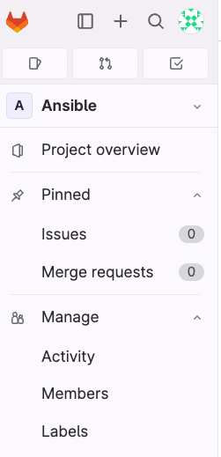
Adding other project members
Nextech Solutions
To Add members to project
click Manage on the side bar
And click Members

Slide 64
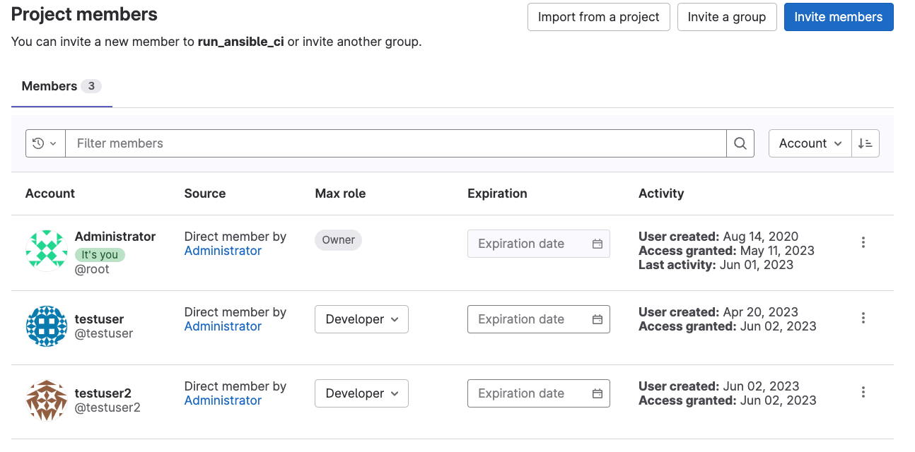
Adding other project members
Nextech Solutions

Slide 65
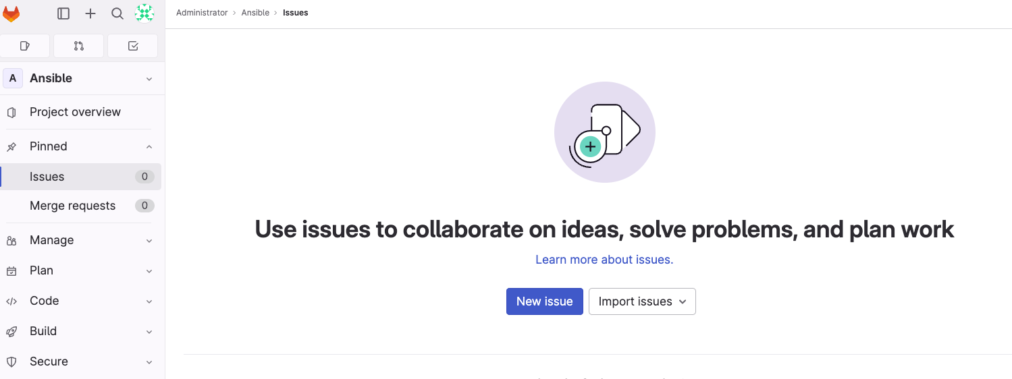
Issues
Nextech Solutions
The issues tab is where you will be doing a lot of project management work, including setting up milestones, writing up feature requests, and assigning work to different contributers.

Slide 66
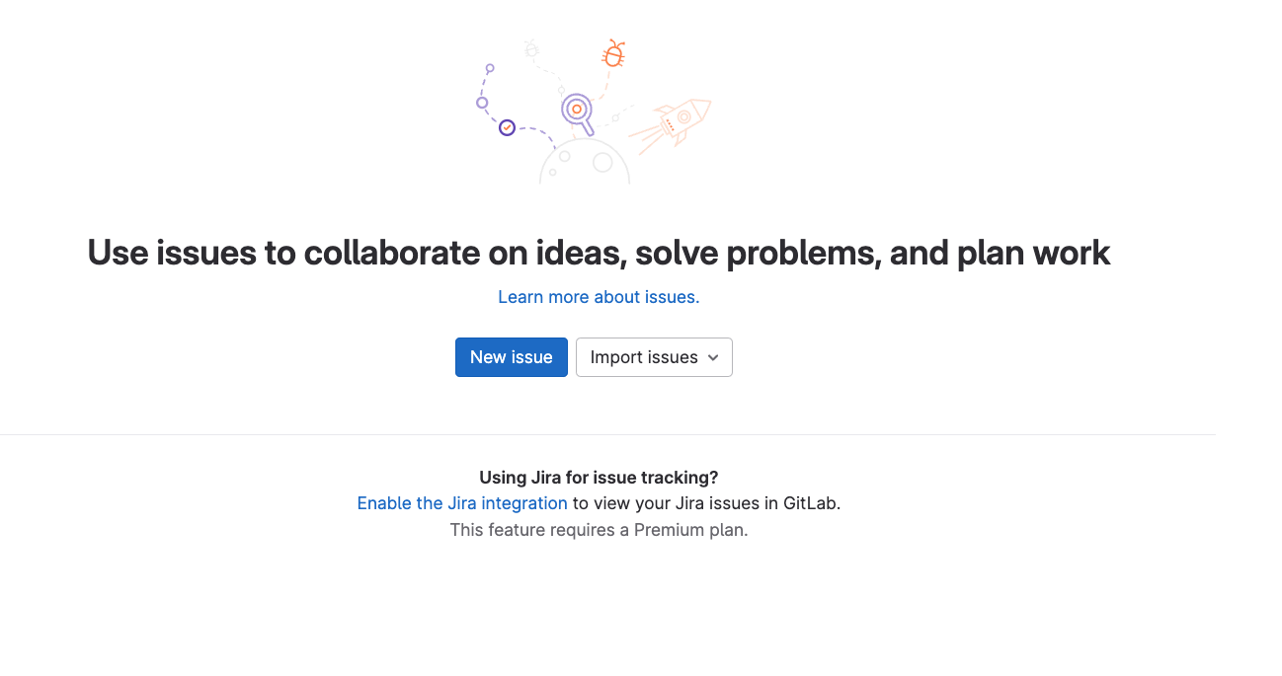
Creating an issue
Nextech Solutions
Go to your project
Click New Issue

Slide 67
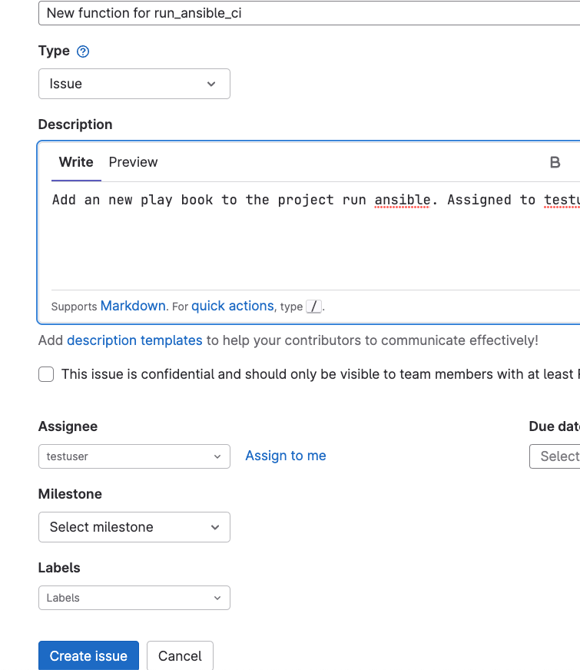
Create issue for Project
Nextech Solutions

Slide 68
Create issue
Nextech Solutions
Add title
Type equals issue, can also be an incident
Description clear and concise
Add an Assignee.
Select a milestone if available or create
Hit the create issue button
Add label when appropriate

Slide 69
Issues
Nextech Solutions
You can user HTML Markup Language

Slide 70
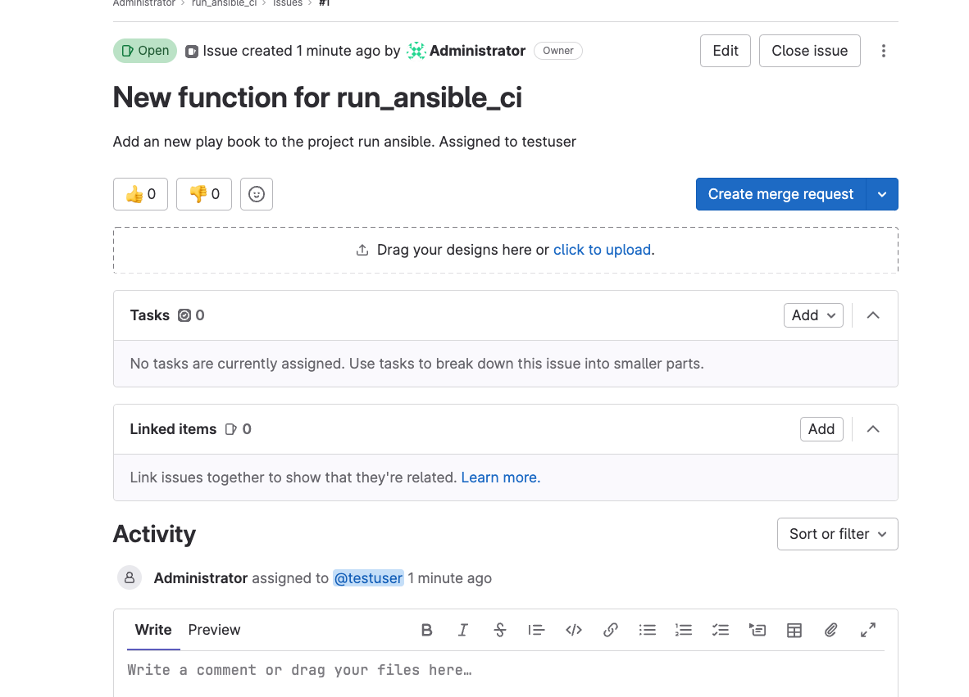
Issue
Nextech Solutions

Slide 71
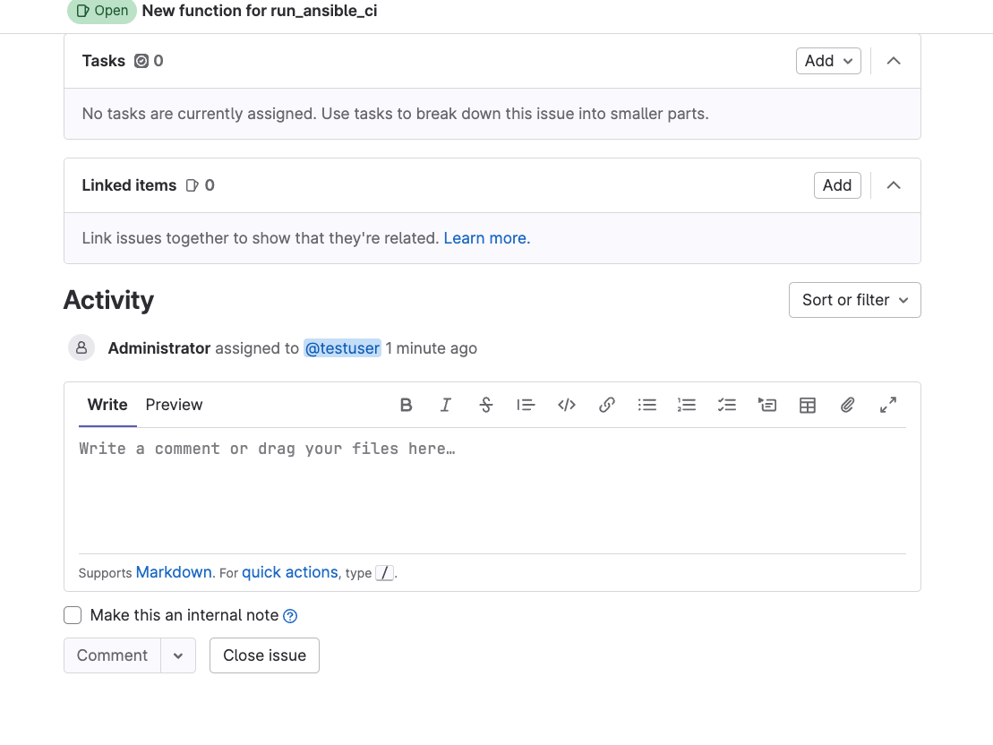
Issues
Nextech Solutions

Slide 72
Issue Comments
Nextech Solutions
You can add comments to an issue by filling out the comments box at the bottom. This is incredibly useful for starting a discussion on a problem. Much like a description when creating an issue, you can use Markdown to format text. You can also tag other project members by typing the @ symbol and then their username or select them from the drop-down list that appears.
Typing a #, followed by and issue number or searching in the drop-down box.
Using a ! Or $ followed by a number will let you reference Merge Requests or Snippets as well.

Slide 73
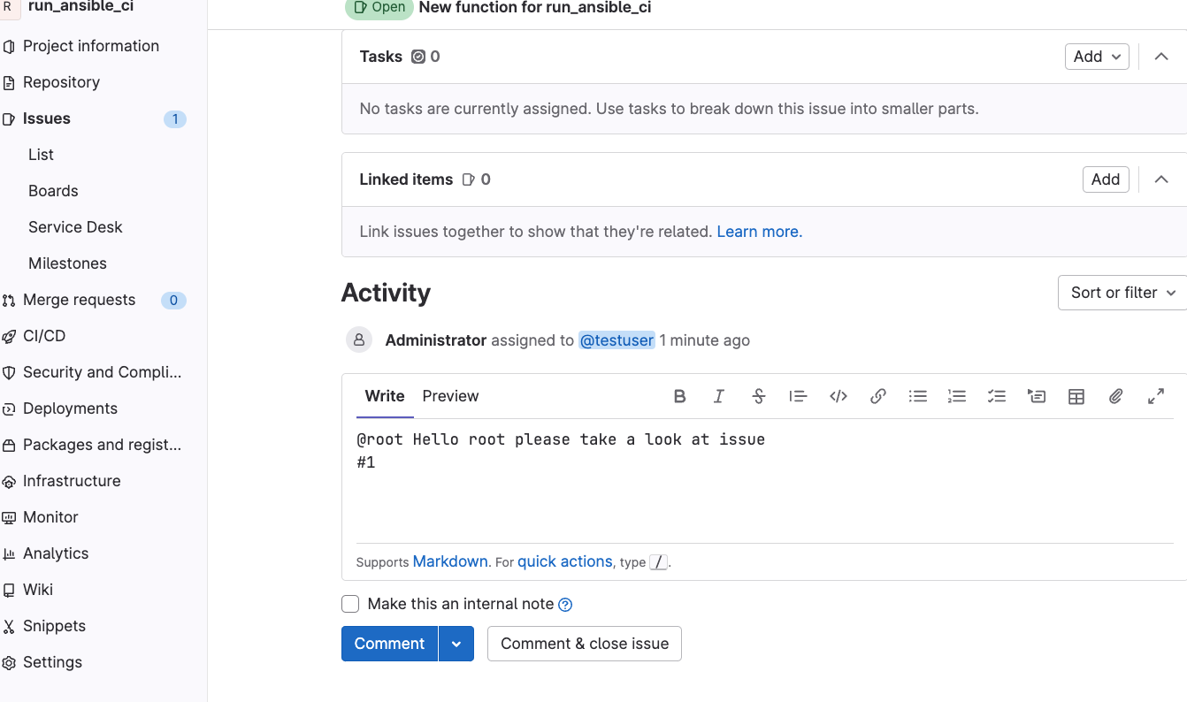
Issue comments
Nextech Solutions
Click Comment when ready!

Slide 74
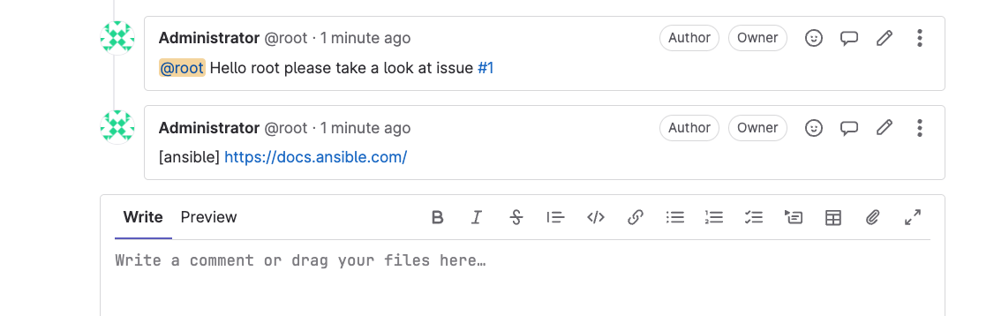
Adding Markup of website
Nextech Solutions

Slide 75
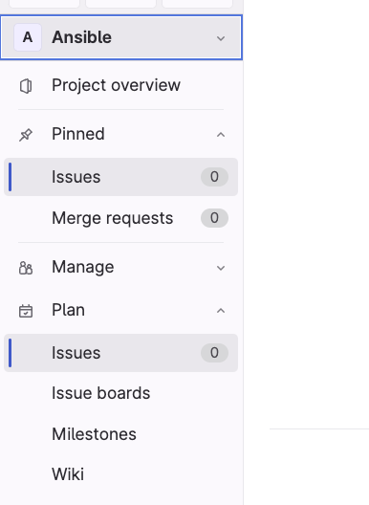
Issue Board
Nextech Solutions
Issue boards are located under
Plan in the project Sidebar

Slide 76
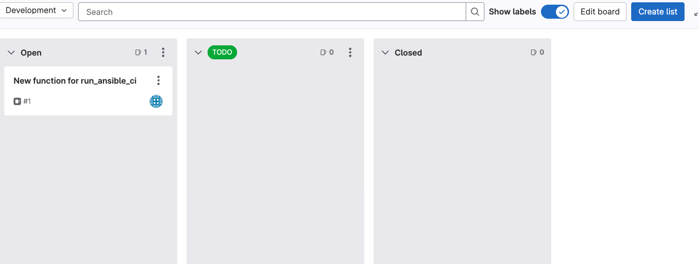
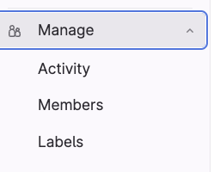
Issue board
You can add other lists (upper right) In this case I added a TODO list. You can drag issues from each list.
Before you do this you must add a label

Slide 77
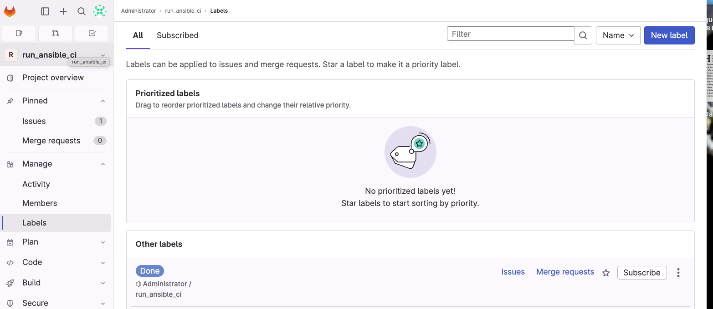
Add Label
Nextech Solutions

Slide 78
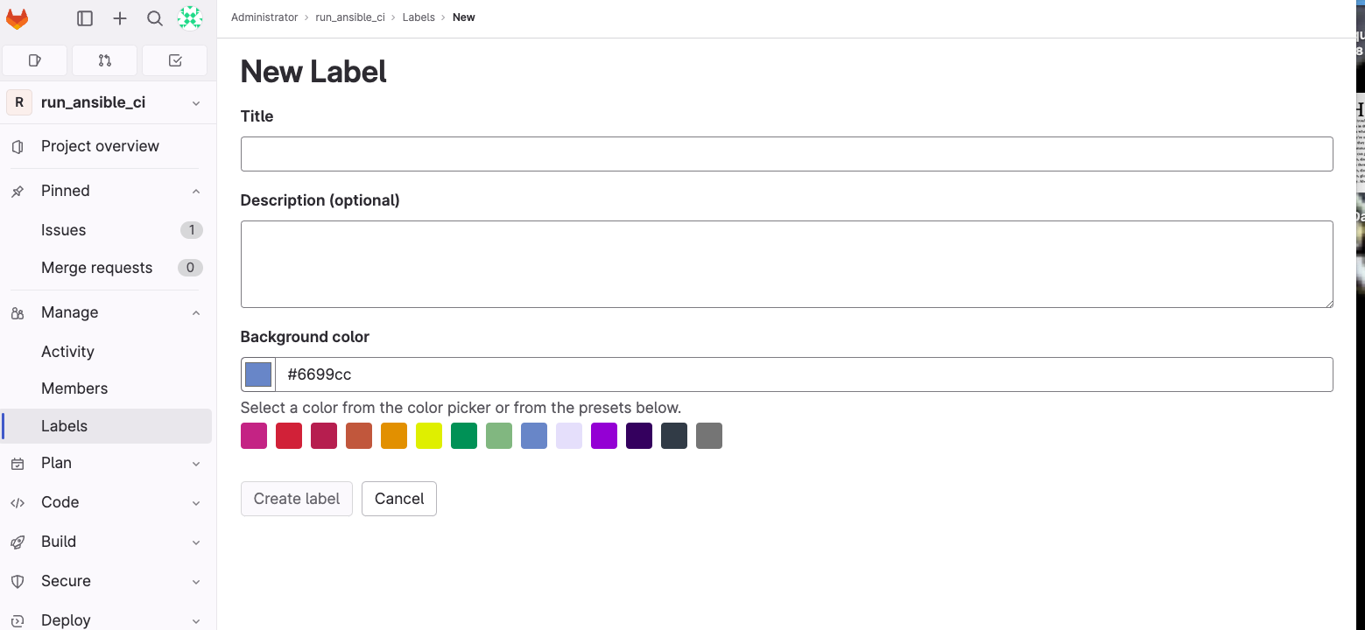
New Label
Nextech Solutions

Slide 79
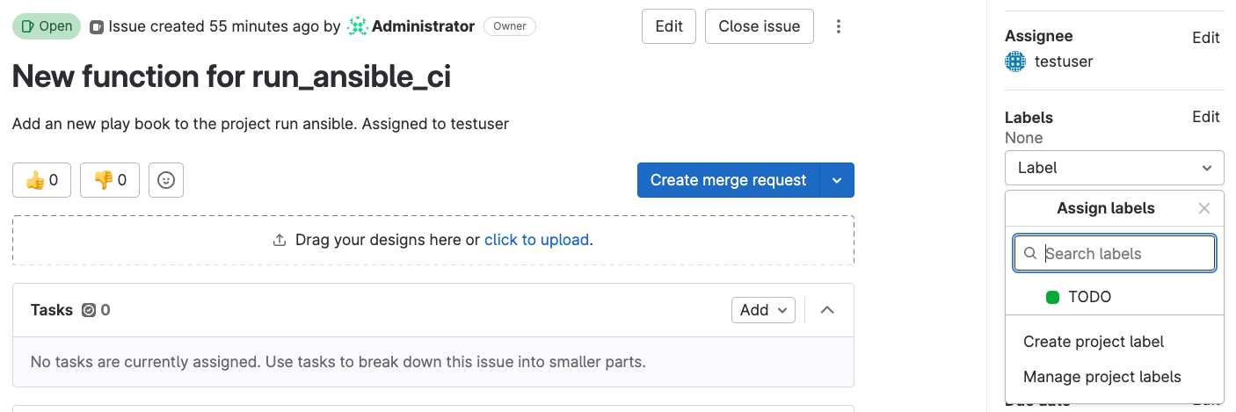
Labels for Issue management
Nextech Solutions

Slide 80
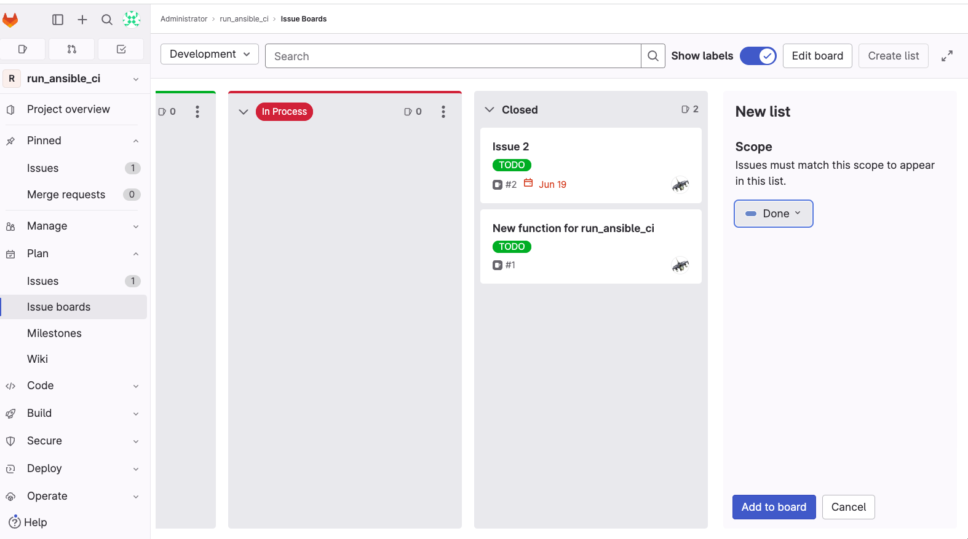
Add new list to Issue board
Nextech Solutions
Click Create list
Select Label
Click add to board

Slide 81
Issue boards
Nextech Solutions
You can move lists on the issue board by just drag and drop.

Slide 82
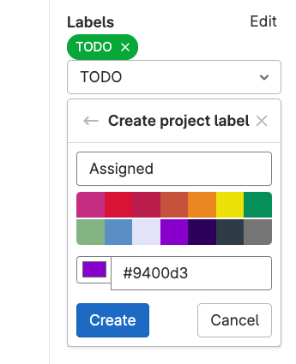
Labels for issue management
Nextech Solutions

Slide 83

Milestones
Milestones offer a way of grouping issues and merge requests that represent a specific release or timeboxed period to get work done.

Slide 84
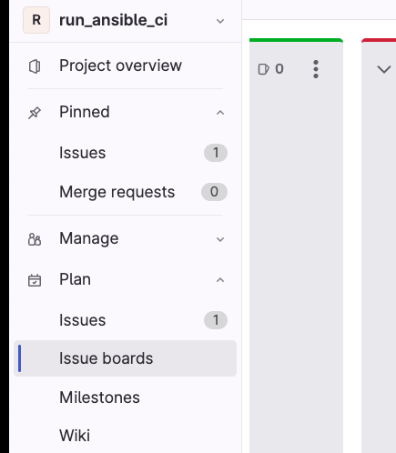
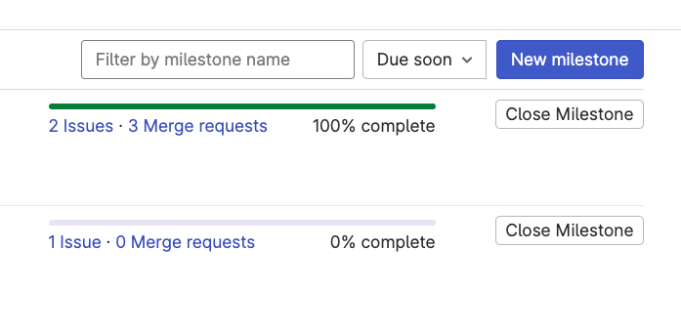
Milestones
Nextech Solutions
You create Milestones by opening up the Plan area on the
Sidebar (where issues are).
Click Milestones and then click New milestone

Slide 85
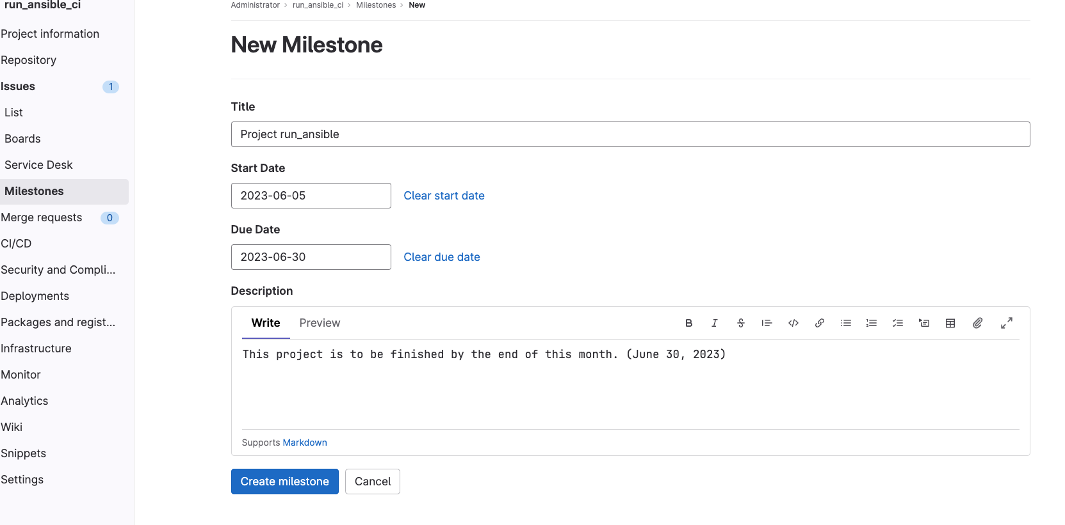
Milestones
Nextech Solutions
Click the Create milestone button

Slide 86
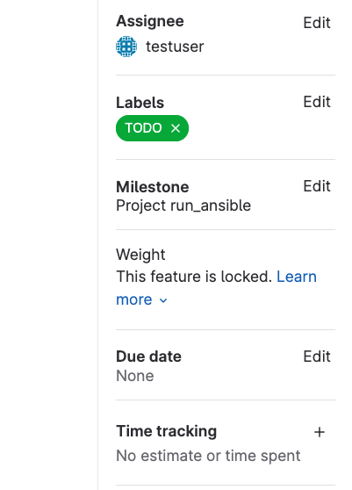
Milestones
Nextech Solutions
Assign Milestone to issue.

Slide 87
Merge requests
Nextech Solutions
Merge requests are tasks that are assigned to someone to merge one branch into another.

Slide 88
Example project
Nextech Solutions
New branches should start with the issue number followed by a hyphen-separated description of the branch.
git branch 1-new-function-for-run_ansible_ci
git checkout 1-new-function-for-run_ansible_ci
Can also be shortened to the following:
git checkout –b 1-new-function-for-run_ansible_ci

Slide 89
Example project
Nextech Solutions
Make changes to .gitlab-ci.yml to add adhoc command to retrieve server settings
vi .gitlab-ci.yml
Insert new adhoc command:
ansible -I ./inventory.ini –m ansible.builtin.setup centos_9
git commit –a –m “#1 add adhoc command”
git push origin 1-new-function-for-run_ansible_ci

Slide 90
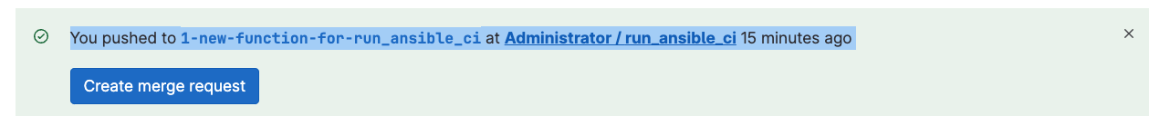
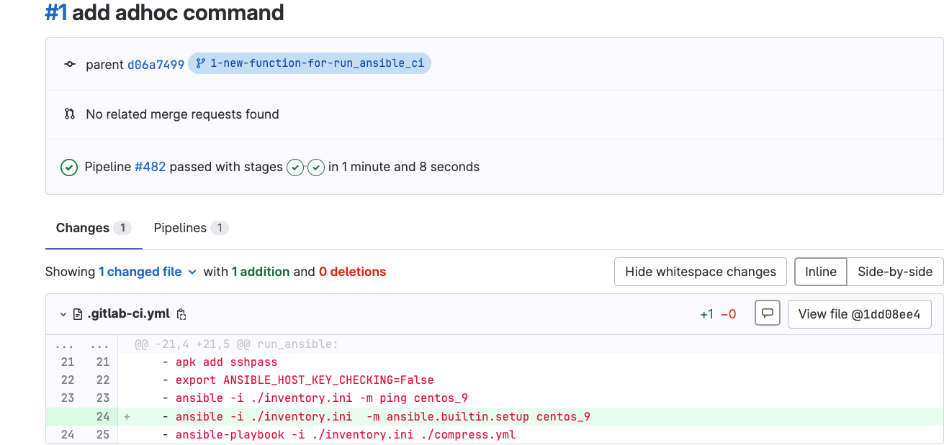
Creating a merge request
Nextech Solutions

Slide 91
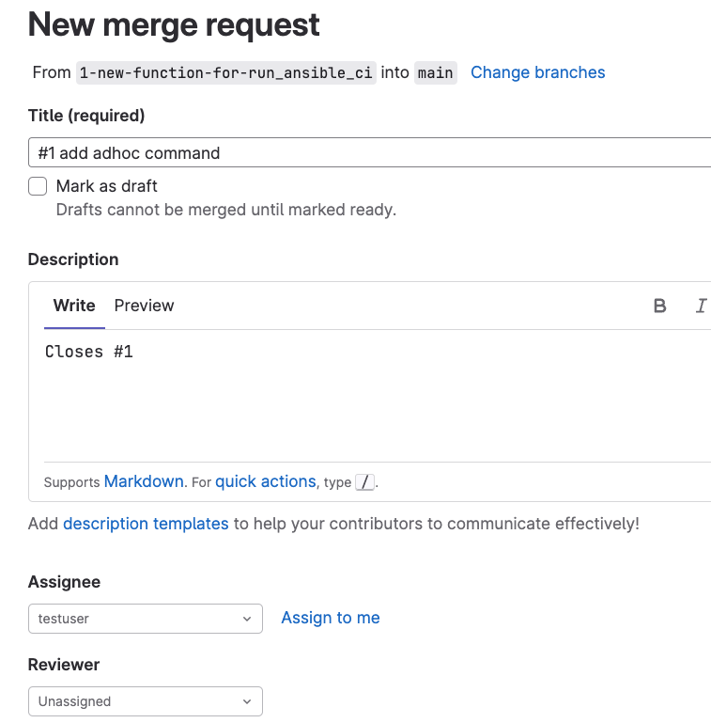
New Merge Request
Nextech Solutions

Slide 92
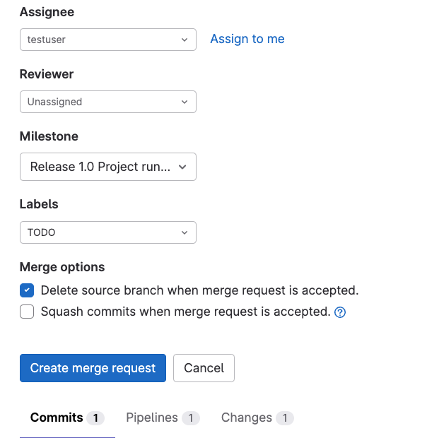
New Merge Request
Nextech Solutions
Click Create Merge request

Slide 93
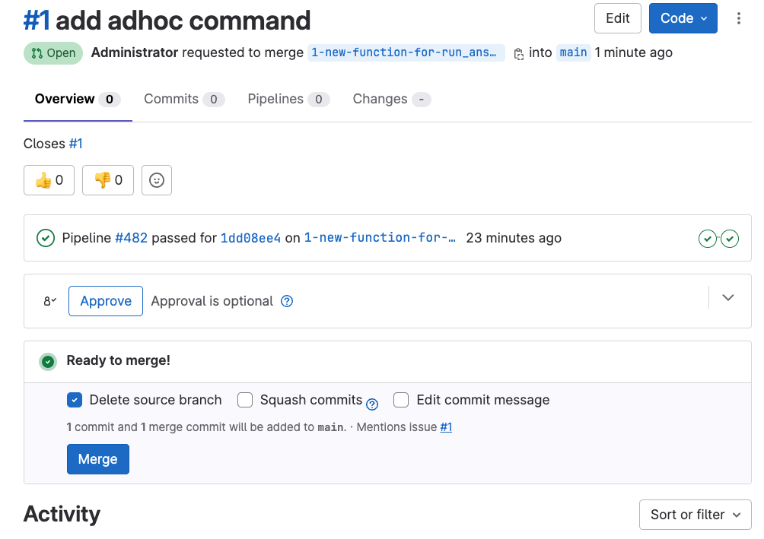
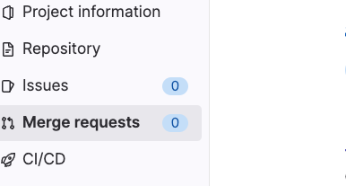
Create Merge Request
Nextech Solutions
After Merge the merge request is gone and the issue
Has be closed and the remote branch has been removed.
Run git branch –d 1-new-function-for-run_ansible_ci to
Remove local branch.
Click Merge

Slide 94
Continuous Integration and Continuous Deployment
Nextech Solutions
How to install Gitlab Runner
Setting up tests in our GitLab example project
The .gitlab-ci.yml file
Setting up a .gitlab-ci.yml file in our GitLab example project
Breaking down advanced .gitlab-ci.yml files
The CI/CD interface in GitLab

Slide 95
How to install Gitlab
Nextech Solutions
nano /etc/apt/sources.list.d/gitlab_gitlab-ce.list
Add the following lines
deb https://packages.gitlab.com/gitlab/gitlab-ce/ubuntu/ focal main
deb-src https://packages.gitlab.com/gitlab/gitlab-ce/ubuntu/ focal main
Sudo apt update && sudo apt upgrade
apt install gitlab-ce -y or gitlab-ee (paid for version)

Slide 96
How to install GitLab
Nextech Solutions
Ubuntu
sudo apt update sudo apt install curl debian-archive-keyring lsb- release ca-certificates apt-transport-https software-properties-common -y
curl -sS https://packages.gitlab.com/install/repositories/gitlab/gitlab-ce/script.deb.sh | sudo bash
apt update –y
apt upgrade –y
cat /etc/apt/sources.list.d/gitlab_gitlab-ce.listgpg_key_url="https://packages.gitlab.com/gitlab/gitlab-ce/gpgkey"

Slide 97
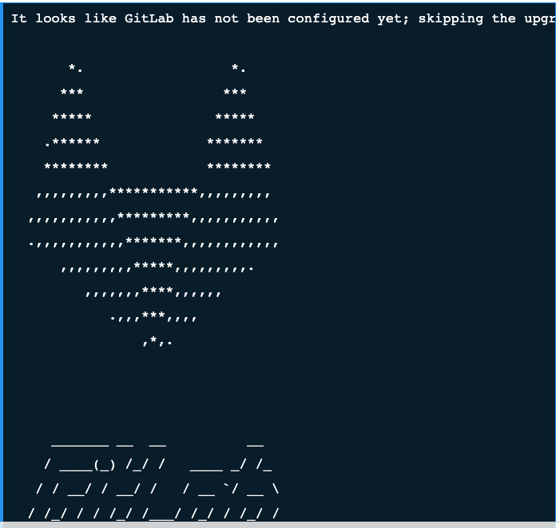
Install Gitlab
Nextech Solutions

Slide 98
Configure GitLab
Nextech Solutions
nano /etc/gitlab/gitlab.rb
Change the following line:
external_url 'http://gitlab.yourdomain.com’
gitlab-ctl reconfigure
Access GitLab cat /etc/gitlab/initial_root_password

Slide 99
Install GitLab Runner on Ubuntu 22.04 LTS
Nextech Solutions
curl -L "https://packages.gitlab.com/install/repositories/runner/gitlab-runner/script.deb.sh" | sudo bash
sudo apt-get install gitlab-runner
apt-cache madison gitlab-runner
sudo apt-get install gitlab-runner=10.0.0
sudo gitlab-runner -version

Slide 100
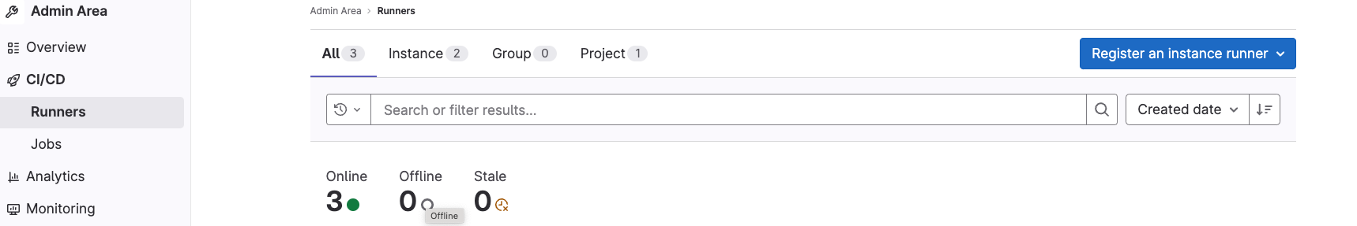
Register GitLab Runner
Nextech Solutions
Get info and go on gitlab-runner server and run the following command.
sudo gitlab-runner register

Slide 101
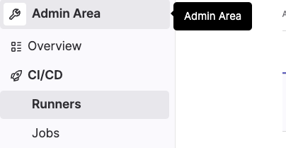
CI/CD Project settings
Nextech Solutions
Go to Admin CI/CD

Slide 102
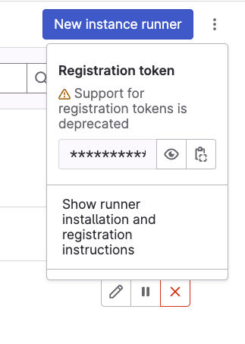

Project settings for CI/CD
Nextech Solutions
sudo gitlab-runner register

Slide 103
Add to project for CI/CD
Nextech Solutions
Add new Issue
Create branch related to new Issue
git branch 2-new-copy-playbook
git push –set-upstream origin 2-new-copy-playbook

Slide 104
Breaking down .gitlab-ci.yml
Nextech Solutions
before_script: runs first
script: Used to define any commands that should be run in a job.
after_script: steps run after a script is run. Used to run even after a failure.

Slide 105
Jobs
Nextech Solutions
Tasks or set of tasks that must be completed by a runner

Slide 106
The stage parameter
Nextech Solutions
Stages are defined at the top level of the YAML file and are used to define separate blocks of jobs. These can be executed in parallel.
They also define the order in which stages are run.

Slide 107
Example of stages
Nextech Solutions
stages:
- build
- test
- deploy
Job 1:
stage: build
script: npm run build dependencies
Job 2:
stage: build
script: npm run build artifacts

Slide 108
Example stages cont.
Nextech Solutions
Job 3:
stage: test
script: npn run test
Job 4:
stage: deploy
script: npn run deploy
In this case, we have defined three stages: build, test, and deploy.
All of the jobs attached to the build stage can be run in parallel, and if they all succeed, the jobs with test stage will be run. If they pass then the jobs in the deploy stage will run.

Slide 109
The image parameter
Nextech Solutions
The image parameter is used to specify which Docker image should be used when running a job. It can be specified as a parameter within a job or at the top level.

Slide 110
The services parameter
Nextech Solutions
This parameter is used to specify extra Docker containers that can be connected to the test image to provision services. This is very handy for setting up databases to connect to, rather than needing to install your database engine on each build run.

Slide 111
The only and except parameters
Nextech Solutions
These parameters are used to limit when a specific job is run.
only is used to limit a job being executed to specified branch or tag names.
except is the opposite: the job will always be run unless it’s on a specified branch or tag.
You can use regular expression or keyword such as branches to refer to all branches, tags to refer to all tags.

Slide 112
Examples of only and except
Nextech Solutions
job:
only:
- /^iss-.*$/
except:
- tags
In this case, the job will only run on references where the label starts with iss-, and will not run on any tags that have been pushed to the repository.

Slide 113
The tags parameter
Nextech Solutions
You can specify a tag or tags in this parameter, which will limit this job to only being executed on Runners that also have the same tag.
Please note that tags are additive, so if you specify multiple tags, the job will only be executed on a Runner that has all of those tags present:

Slide 114
tags example
Nextech Solutions
job:
tags:
- erlang
- postgres
- yamllint
This job will only run on Runners that have erlang, postgres, yamlint tags.

Slide 115
The allow_failure parameter
Nextech Solutions
This parameter requires a Boolean response, either true or false.
When false the pipeline will execute as normal and any failures in the job will halt the rest of the pipeline.
However, when set true, that particular job can fail without stopping later tasks.
The pipeline will still show green, but will have a CI Build passed with warnings message displayed to alert users to the failed stage.

Slide 116
The when parameter
Nextech Solutions
The when parameter can be one of four values, and controls under which conditions a job is run.
on_success: The default behavior; a job will only be executed if the preceeding jobs/stages have passed.
on_failure: The job will only run if at least one job earlier in the pipeline has failed.
always: The task will always be executed, on both success and failures.
manual: A task that requires manual intervention to be started, such as from the GitLab web UI

Slide 117
when example
Nextech Solutions
stages:
- build
- cleanup_build
build_job:
stage: build
script:
- webpack
Cleanup_build_job:
stage: cleanup_build
script:
- rm /dist/*
when: on_failure

Slide 118
when example
Nextech Solutions
In the preceding case, the build job is always executed and attempts to use webpack to build our JavaScript assets, but if it fails, the cleanup_build_job task will be run, deleting any files that were created by the former task.

Slide 119
The environment parameter
Nextech Solutions
The environment parameter is used to specify a particular environment to which a job will be deployed.
The environment key can contain multiple other keys, most commonly name and url.
The name sub-key defines a name for an environment to which the code will be deployed.
This should be created in Projects|Operations|Environments
but can also created on the fly in .gitlab-ci.yml

Slide 120


Environments gui interface
Nextech Solutions

Slide 121


The cache parameter
Nextech Solutions
To speed up build processes, you can cache certain files and directories between jobs and between different pipeline executions using the cache keyword.
You can manually clear caches from the GitLab web user interface.

Slide 122
cache - paths
Nextech Solutions
This is an array of paths to files and/or directories that should be cached. You can also use the asterisk wildcard character (*).
build:
cache:
paths:
- binaries./*.apk
- .config

Slide 123
cache - key
Nextech Solutions
This takes a string that can be used to create separate caches for different jobs or branches, see the following example

Slide 124
cache key example
Nextech Solutions
test:
cache:
key: ”$CI_COMMIT_REF_SLUG”
paths:
- binaries/
stages:
- build
- test
build_job:
stage: build

Slide 125
cache key example cont-
Nextech Solutions
script: npn run build
cache:
key: build-key
paths:
- public/
test_job:
stage: test
script: npm run test
cache:
key: test-key

Slide 126
cache key example cont-
Nextech Solutions
paths:
- vendor/
Without a key value, this would mean that the second job to run (test_job)
would reuse the cache from build_job and at the end of its run would cache
the vendor/ directory. This cache will overwrite the existing cache from build_job,
which means that next time the pipeline runs, the cache will only contain the vendor/
directory (as that was the only thing defined to be cached by the last running job)
and the cache will be useless to build_job. To prevent this happening,
we use a separate cache key, which means that each time the pipeline is run,
build_job will grab the cache stored under the build-key value and test_job
will use the cache stored under test-key.

Slide 127
cache - untracked
Nextech Solutions
This is a simple helper option that you can set to true in order to cache any files that are untracked by git at the end of a job run. This is handy for caching the output left over from package installations or program compilation.

Slide 128
cache - policy
Nextech Solutions
Under default circumstances, the cache is downloaded before every job and then re-uploaded at the end of the job. This is equivalent to setting the following:
job:
cache:
policy: push-pull

Slide 129
cache policy
Nextech Solutions
You may have a pipeline with jobs that would use a cache but not alter the contents of the cache. A good example is having one job that downloads all of the required packages and builds assets, and then subsequent jobs that simply run tests. In these cases, you can set policy: pull, which will download the cache at the start of the job but skip the uploading phase to save time. Conversely, if you have a job that always creates the contents of a cache, you can set policy: push, which will skip the download phase but always run the upload step at the end of the job.

Slide 130
The artifacts parameter
Nextech Solutions
The artifacts parameter is used to define a list of files and directories that should be attached to a job after success. They are packaged and sent to the GitLab instance (either your self-hosted one or GitLab.com) and become available for download through the web user interface.

Slide 131
artifacts - paths
Nextech Solutions
package:
artifacts:
paths:
- public/
- tests/*.html
In this case, everything in public/ directory as well as any HTML files in the tests/ directory will be zipped, uploaded, and made available for download in the web user interface.

Slide 132
artifacts - name
Nextech Solutions
By default, any uploaded files will be stored in a .zip archive titled artifacts.zip. You can use the name parameter to change the default filename (it will still end with .zip), as demonstrated in the following code:

Slide 133
artifacts – name example
Nextech Solutions
package:
artifacts:
name: taclan_project
In the preceding example, every time this job is completed, a zipped file called taclan_project.zip will be uploaded to GitLab and made available for download in the web UI.

Slide 134
artifacts - example
Nextech Solutions
GitLab variables such as CI_JOB_NAME (the name of the currently running GitLab CI job) or CI_COMMIT_REF_NAME (the name of the branch/tag) to create dynamically named artifacts like in this example: package:
artifacts:
name: "$CI_JOB_NAME-$CI_COMMIT_REF_NAME”
The preceding example will label every artifact with the current job name (in this case, package) and the current git branch name, separated by a hyphen and followed by .zip.

Slide 135
artifacts - untracked
Nextech Solutions
Much like the untracked key in the cache section, artifacts:untracked is a boolean variable that can be set to true in order to collect all untracked files and upload them as artifacts.

Slide 136
artifacts - when
Nextech Solutions
The when key can have one of three different values and controls under what circumstances artifacts are uploaded:
on_success: Only upload artifacts when the job is successful (default).
on_failure: Only upload artifacts when the job fails. This is useful if you want to examine failed builds.
always: Upload artifacts, regardless of whether the job succeeds or not.

Slide 137
artifacts – expire_in
Nextech Solutions
The expire_in sub-parameter is provided with a string defining how long artifacts should be kept for in the GitLab instance. If this is not specified, it defaults to the instance setting, which is 30 days by default for self-hosted GitLab or forever for GitLab.com projects. Some examples of strings that you can provide include the following:
42 weeks
42 days
42 mins 42 secs
2 mos 1 day
42 years 6 mos 6 hrs
1 week and 2 days

Slide 138
The variables parameter
Nextech Solutions
You can store variables per job or globally using the variables keyword. The value for variables should be an array of key/value pairs that can be represented by strings or integers (for both key and value), although typically the key will be an all-capitalized string for ease of recognition.
Locally defined variables will override their globally defined counterparts, but to have a job run with no access to globally defined variables, you should redeclare it with an empty array like so:
cool_job_name:
variables: {}

Slide 139
Other parameters
Nextech Solutions
So far, we've covered the majority of the parameters that are available to jobs, including a bunch of ones that can be used at the top level to apply to all jobs. It's worth noting that there are other ones such as dependencies, coverage, and so on that are beyond the scope of this presentation, but can be found in the GitLab CI documentation online.

Slide 140
Advanced .gitlab-ci.yml
Nextech Solutions
image: bitnami/laravel:latest
services:
- postgres:9.6
variables:
POSTGRES_DATABASE: postgres
POSTGRES_PASSWORD: password
DB_HOST: postgres
DB_USERNAME: root

Slide 141
Advanced .gitlab-ci.yml – cont.
Nextech Solutions
stages:
- test
- package
- deploy
php_unit_test:
stage: test
script:
- cp .env.example .env
- composer install
- php artisan key:generate
- php artisan migrate
- vendor/bin/phpunit
cache:

Slide 142
Advanced .gitlab-ci.yml – cont.
Nextech Solutions
key: composer
paths:
- vendor/
js_unit_test:
stage: test
script:
- npm install
- npm run test
package_upload:
stage: package
script:
- composer install
- npm install

Slide 143
Advanced .gitlab-ci.yml – cont.
Nextech Solutions
- webpack
cache:
key: composer
paths:
-vendor/
policy: pull
artifacts:
paths:
- public/
expire_in: 1 week
only:
- tags
deploy_production:
stage: deploy

Slide 144
Advanced .gitlab-ci.yml – cont.
Nextech Solutions
script:
- composer install
- npm install
- webpack
- .composer/vendor/bin/envoy run deploy
environment:
name: production
url: http://192.168.0.1
when: manual
only:
- master

Slide 145
Break down of .gitlab-ci.yml
Nextech Solutions
The header of the .gitlab-ci.yml file defines an image to use from the Docker Registry (image: bitnami/laravel:latest), as well as defining a service (in this case, the postgres:9.6 image, also from the Docker registry). This service container will be attached directly to our Laravel image to provide a database without needing to set up a database as part of a before_script each time a job is run:
image: bitnami/laravel:latest
services:
- postgres:9.6

Slide 146
Break down of .gitlab-ci.yml – cont.
Nextech Solutions
The variables that are declared all relate to our database and will be used in the jobs so that we can connect to our database service image. Of particular note is the DB_HOST parameter, which simply specifies postgres as the hostname. This is because with GitLab CI, any services that are connected are referred to by their image name, in this case, postgres:
variables:
POSTGRES_DATABASE: postgres
POSTGRES_PASSWORD: password
DB_HOST: postgres
DB_USERNAME: root

Slide 147
Break down of .gitlab-ci.yml – cont.
Nextech Solutions
Next, we define three stages that we want: test, package, and deploy. These stages will be run sequentially (and any errors in an earlier stage will cause the whole pipeline to be canceled): stages:
- test
- package
- deploy

Slide 148
Break down of .gitlab-ci.yml – cont.
Nextech Solutions
During the test stage, we'll have two separate jobs that can be run simultaneously (provided there are enough available Runners). php_unit_test and js_unit_test don't depend on one another, so they can safely be run together without causing problems. Both jobs are quite similar in that they have mostly the same parameters, although their scripts each perform very different functions. The big difference between the two is that php_unit_test also contains a cache section, which means that after the job is finished, the entire vendor/ directory will be zipped up and stored under the composer key for reuse in future jobs and pipelines.

Slide 149
Break down of .gitlab-ci.yml – cont.
Nextech Solutions
This helps reduce the time taken to build and execute subsequent runs of this job and any other jobs that use the same cache. Once both jobs are finished (and both are successful), the next stage can begin: php_unit_test:
stage: test
script:
- cp .env.example .env
- composer install
- php artisan key:generate
- php artisan migrate
- vendor/bin/phpunit

Slide 150
Break down of .gitlab-ci.yml – cont.
Nextech Solutions
cache:
key: composer
paths:
- vendor/
js_unit_test:
stage: test
script:
- npm install
- npm run test

Slide 151
Break down of .gitlab-ci.yml – cont.
Nextech Solutions
The package_upload job is the only component of the package stage, and consists of a script that installs all of the required dependencies and compiles all the front-end elements. To speed up this process, we use the cache key, which should download the cache used in the earlier php_unit_test if it's available. For this example, we've also set the policy to pull to demonstrate it. This means that while it will download any available cache stored under the composer key, it will not re-upload any files once the job has finished. This task will also only operate on tagged commits, which is handy if you're doing versioned releases of software. Once all of the scripts have been executed, all of the files in the public/ directory will be packaged and uploaded as artifacts and stored for up to a week:

Slide 152
Break down of .gitlab-ci.yml – cont.
Nextech Solutions
package_upload:
stage: package
script:
- composer install
- npm install
- webpack
cache:
key: composer
paths:
-vendor/
policy: pull
artifacts:
paths:
- public/
expire_in: 1 week
only:
- tags

Slide 153
Break down of .gitlab-ci.yml – cont.
Nextech Solutions
The last stage to run is deploy_production, which will only be available if the preceding stages have completed successfully. Note that if a job (such as package_upload) doesn't run because it isn't a tagged release, the stage can still be considered to have run successfully. The deploy_production task will run a script that installs all of the dependencies and prepare any necessary files and then deploy itself. This code will only run when pushed to the master branch:

Slide 154
Break down of .gitlab-ci.yml – cont.
Nextech Solutions
deploy_production:
stage: deploy
script:
- composer install
- npm install
- webpack
- .composer/vendor/bin/envoy run deploy
environment:
name: production
url: http://192.168.0.1
when: manual
only:
- master

Slide 155

GitLab CI/CD web ui
Nextech Solutions

Slide 156


Check your .gitlab-ci.yml
Nextech Solutions

Slide 157

Job listing
Nextech Solutions

Slide 158


CI/CD Analytics
Nextech Solutions

Slide 159

Environments
Nextech Solutions

Slide 160

Importing repositories
Nextech Solutions

Slide 161

Import repositories
Nextech Solutions

